Slide 1
Software Engineering
Dept of Information Science
B.V.Bhoomaraddi College of Engg. & Tech.
By : Devendra.B.Hupri
Kartik.Venugopal Sudheer.Bidarahalli Tejaraj.Lingadhal

Slide 2
Introduction
Software Engineering is the systematic approach to development, operation, maintenance, and retirement of software.
Software is a collection of programs, procedures, rules, and associated documentation and data (IEEE).
There are two categories of software’s they are:
Industrial Strength Software
Student Strength Software
BVBCET

Slide 3
Software
Student
Developer is the user
SW not in critical use
Reliability, robustness not important
No investment
Don’t care about portability
Industrial Strength
Others are the users.
Supports important functions / business
Reliability , robustness are very important
Heavy investment
Portability is a key issue here
BVBCET

Slide 4
Software Process
Process is distinct from product – products are outcomes of executing a process on a project.
A set of steps, along with ordering constraints on execution, to produce software with desired outcome
Many types of activities performed by diff people in a software project
Better to view software process as comprising of many component processes
BVBCET

Slide 5
Process Models
A process model specifies a general process, usually as a set of stages
This model will be suitable for a class of projects
i.e. a model provides generic structure of the process that can be followed by some projects to achieve their goals
BVBCET

Slide 6
Common Process Models
Waterfall Model
Prototyping Model
Iterative Model
Spiral model
BVBCET

Slide 7
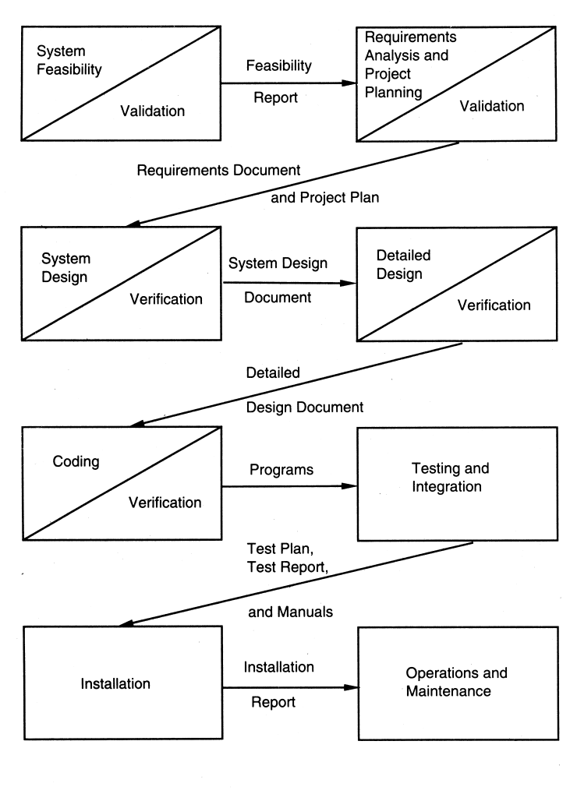
Waterfall Model
BVBCET

Slide 8
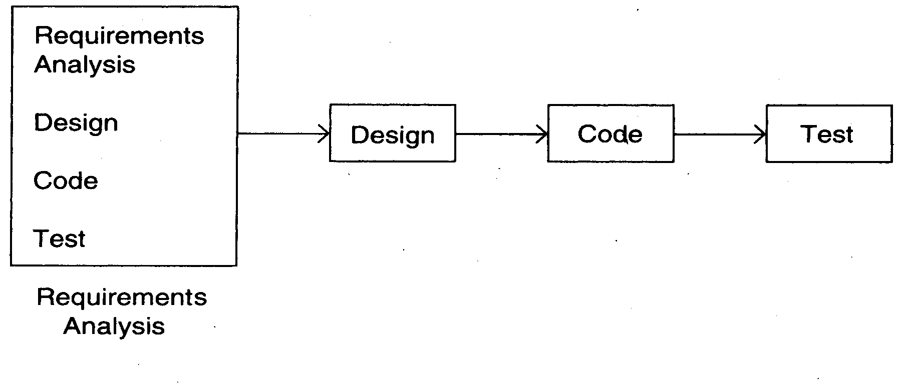
Prototyping
BVBCET

Slide 9
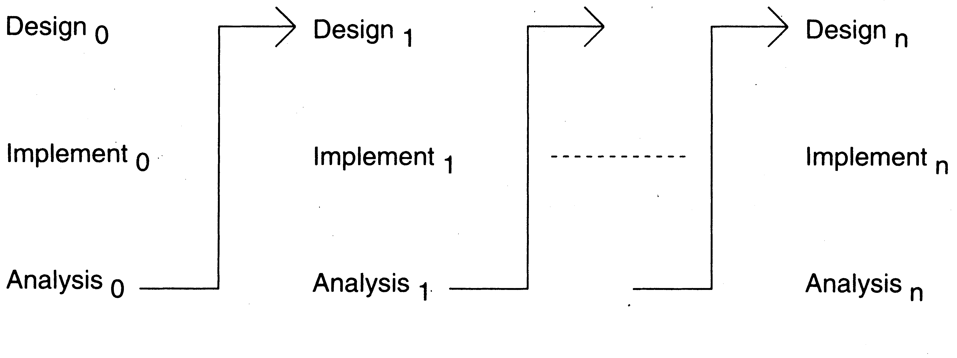
Iterative Model
BVBCET

Slide 10
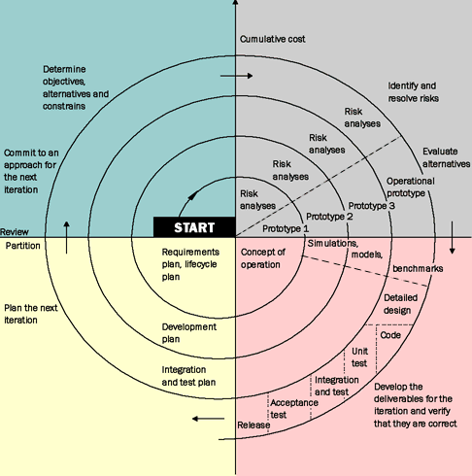
Spiral Model
BVBCET

Slide 11
Requirement analysis
Understanding user requirements is an integral part of information systems design and is critical to the success of interactive systems.
It is now widely understood that successful systems and products begin with an understanding of the needs and requirements of the users.
User-centered design begins with a thorough understanding of the needs and requirements of the users.
The benefits can include increased productivity, enhanced quality of work, reductions in support and training costs, and improved user satisfaction.
BVBCET

Slide 12
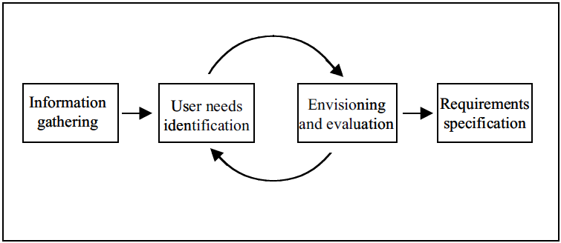
General process for user requirements analysis
BVBCET

Slide 13
Testing
Testing is the process of exercising a program with the specific intent of finding errors prior to delivery to the end user.
Role of Testing:
There will be requirement defects, design defects and coding defects in code
These defects have to be identified by testing.
Therefore testing plays a critical role in ensuring quality.
All defects remaining from before as well as new ones introduced have to be identified by testing.

Slide 14
Who Tests the Software?
developer
independent tester
Understands the system.
and, is driven by "delivery"
Must learn about the system,
but, will attempt to break it
and, is driven by quality
BVBCET

Slide 15
Testing Strategy
System engineering
Analysis modeling
Design modeling
Code generation
Unit test
Integration test
Validation test
System test
BVBCET

Slide 16
Unit Test Environment
driver
interface
local data structures
Module
boundary conditions
independent paths
error handling paths
stub
stub
test cases
RESULTS
BVBCET

Slide 17
Integration Testing Strategies
Two Options:
The “big bang” approach
Incremental construction in strategy
Top Down Strategy.
Bottom Up strategy.
BVBCET

Slide 18
Top Down Integration
A
top module is tested with
stubs
B
F
G
stubs are replaced one at
a time, "depth first"
C
as new modules are integrated,
some subset of tests is re-run
D
E
BVBCET

Slide 19
Bottom-Up Integration
A
B
F
G
drivers are replaced one at a
time
C
worker modules are grouped into
builds and integrated
D
E
cluster
BVBCET

Slide 20
Regression testing is the re-execution of some subset of tests that have already been conducted to ensure that changes have not propagated unintended side effects
System Testing tends to affirm the end-to-end quality of the entire system. System testing is often based on the functional requirement specification of the system. Non-functional quality attributes such as reliability, security, and maintainability are also checked.
Acceptance Testing is done when the completed system is handed over from the developers to the customers or users. The purpose of acceptance testing is rather to give confidence that the system is working than to find errors.
BVBCET

Slide 21
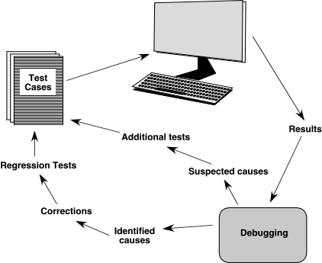
The Debugging Process
BVBCET

Slide 22
Conclusion
The ultimate goal of Software Engineering is to help designers, developers, and managers develop systems with high quality.
The testing of software is an important means of assessing the software to determine its quality.
Software must be efficient ,reliable, maintainable, re-usable, user-friendly.

Slide 23
Q/A ?
BVBCET

Slide 24
Thank You
BVBCET

